Slide 1
What is Patient Blood Management?
A Patient’s Guide

Slide 2
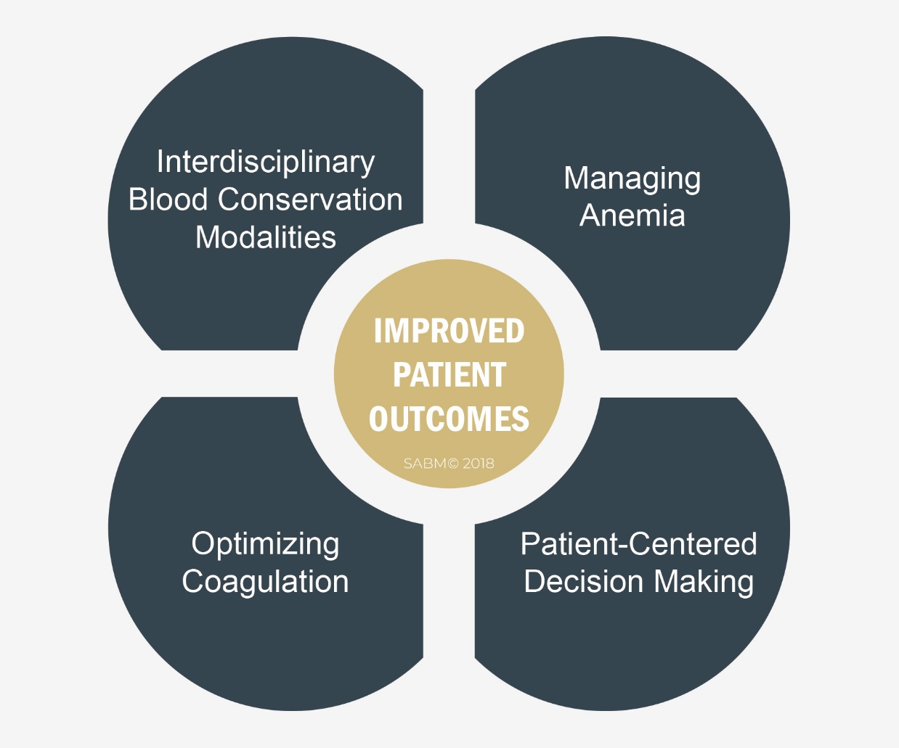
What is Patient Blood Management?
Patient Blood Management (PBM) is the scientific use of safe and effective medical and surgical techniques designed to prevent anemia and decrease bleeding in an effort to improve patient outcome.

Slide 3
Why Patient Blood Management?
Improves patient outcomes.
Increases patient safety by minimizing or eliminating exposure to transfused blood.
Can reduce the risk of complications and infections.
Decreases costs to the healthcare system.

Slide 4
How is Patient Blood Management valuable?
Encourages patients to participate in their own plan of care.
Advance planning to build blood counts before procedures leads to increased safety.
Patient Blood Management strategies and techniques may lead to fewer infections and better outcomes.
Minimizes unnecessary blood loss, making patient care safer.

Slide 5
PBM in surgery
Peri-operative
Maximize & conserve blood production after surgery
Minimize blood loss during surgery
Optimize patient before surgery

Slide 6
PBM surgical Strategies
Optimize patient before surgery
Assess patient fitness for surgery.
Correct bleeding disorders.
Assess medications and herbs that increase bleeding.
Correct anemia.
Develop individualized plan of care.
Adapted from Goodnough LT, et al. Transfusion. 2003;43:668-676.
Notes:
Strategies to reduce surgical patients’ exposure to allogeneic blood can be broken down into those that are appropriate during the preoperative, intraoperative, and postoperative periods.

Slide 7
PBM surgical Strategies
Minimize blood loss during surgery
Precise surgical technique.
Surgical devices that control bleeding.
Drugs that control bleeding.
Minimally invasive technology.
Anesthesia & fluid management.
Blood salvage.

Slide 8
PBM surgical Strategies
Maximize & conserve blood production after surgery
Monitor and correct bleeding.
Increase patient blood production.
Minimize blood sampling.

Slide 9
PBM: What Can Patients Do to Improve their Outcomes?
Choose a practitioner familiar and comfortable with Patient Blood Management strategies.
Know your blood counts.
Discuss with your practitioner risks and benefits of treatment options so you can make a choice that’s good for you.
Regularly visit your practitioner for checkups and screenings.

Slide 10
Choose a hospital with a patient blood management program
A hospital-based philosophy that
every drop of blood counts
To find a hospital with a patient blood management program in your area visit www.sabm.org or click on the link below.
https://www.sabm.org/patient-blood-management-programs/

Slide 11
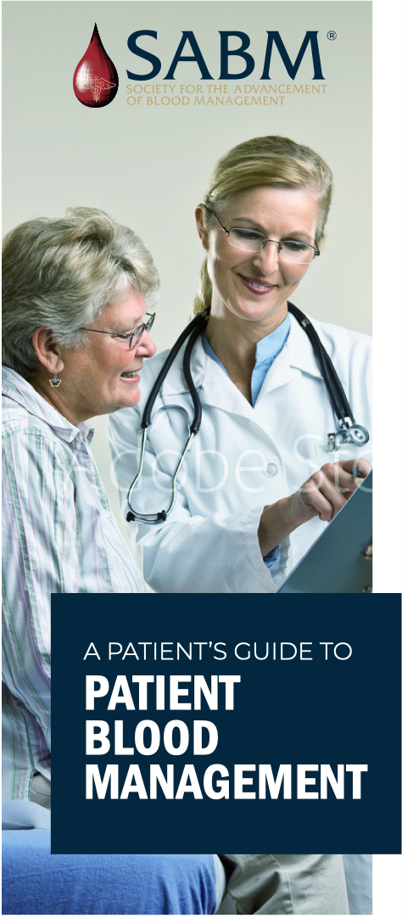
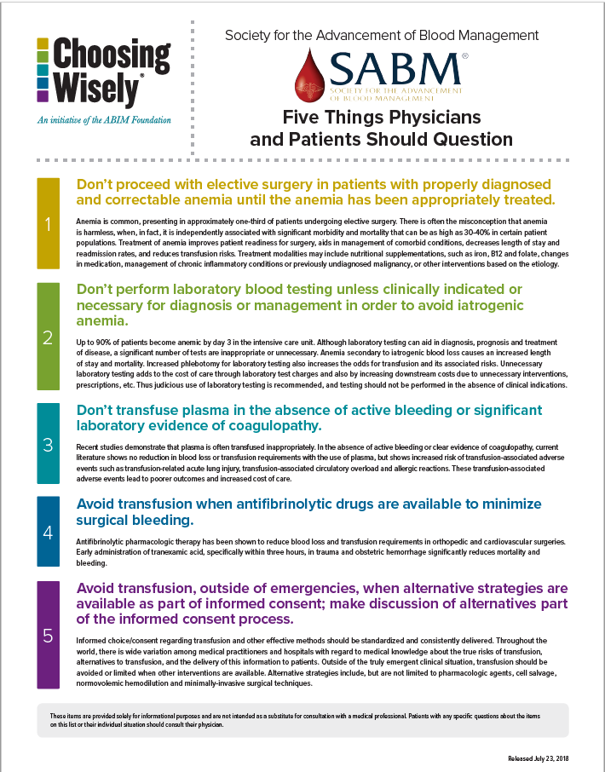
Become an Educated Consumer
Download SABM’s A Patient’s Guide to Patient Blood Management
at SABM.org > Publications
Consider SABM’s Choosing Wisely® list of Five Things Physicians and Patients Should Question at SABM.org > Publications

