Slide 1

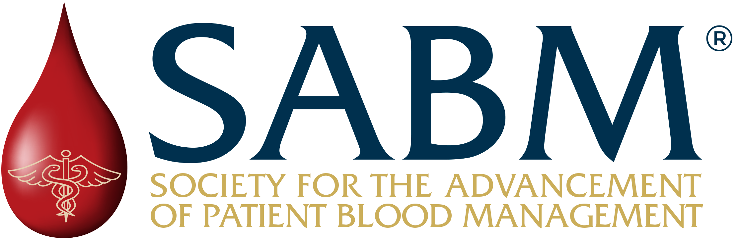
Patient Blood Management (PBM): A Strategic Lever for Healthcare System Performance
Notes:
A leadership briefing deck to support internal discussion and evaluation of PBM.

Slide 2
Executive Orientation
SECTION 1

Slide 3
The Leadership Tension
How do we improve outcomes, stabilize margins, and reduce operational strain without major capital investment?
Accountability
for Outcomes
Rising Acuity
Margin
Compression
Workforce
Fatigue
Notes:
These pressures are converging across health systems. The question for leaders is how to address them without adding complexity or capital.

Slide 4
The Hidden Performance Gap
Most systems still manage blood as a cost center.
Leaders need to operationalize patient blood management as a performance lever.
Notes:
Many organizations manage blood primarily as a cost center: something stored, ordered, and transfused.
But from a leadership perspective, patient blood management is actually a performance lever that drives system performance and financial value. When patient blood health is poorly optimized, resource utilization and transfusion increases, complications rise, length of stay prolongs, and capacity is lost.
This creates a system-level performance gap hiding in plain sight.

Slide 5
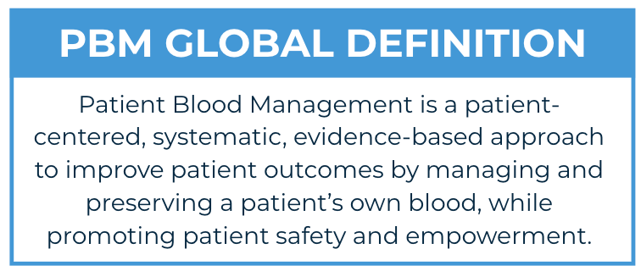
What is Patient Blood Management (PBM)?
In executive terms, PBM is a system-wide performance strategy that
Improves outcomes
Strengthens operational reliability by improving patient readiness, throughput, and OR flow
Reduces cost and complications
Enables revenue-generating clinical services
by optimizing patients’ blood health across the continuum of care.
Source: Shander A. et al. Anesth Analg 2022; 135(3): 476-488
Notes:
In simple terms, PBM is about optimizing patients’ blood health to improve outcomes and system performance.
PBM protects and preserves the patient's blood, a liquid organ in the same manner as other organs. It is both ethically and medically sound.
This is not about doing more medicine. It’s about doing the right medicine, more consistently.

Slide 6
Value & Evidence
SECTION 2

Slide 7
Why PBM Matters: Patients
Improving patients’ blood health by treating anemia and avoiding unnecessary blood loss results in:
Fewer complications
Shorter hospital stays
Reduced infection rates
Fewer readmissions
Avoidance of life-threatening transfusion-related risks such as transfusion-related acute lung injury (TRALI), transfusion-associated circulatory overload (TACO), and hemolytic reactions

Slide 8
Why PBM Matters: Hospitals & Clinicians
Enhances quality while reducing avoidable costs
Improves surgical readiness
Decreases variation in transfusion practice
Shortens length of stay
Strengthens operational reliability
PBM enables hospitals to deliver safer care with better use of existing resources.

Slide 9
Why PBM Matters: Community & Trust
Signals a modern, evidence-based approach to care Patient blood health is proactively managed as part of high-quality medicine
Builds confidence in clinical decision-making Emphasizing prevention, optimization, and safety over reactive care
Strengthens trust in care delivery Reinforcing that patient well-being guides how care decisions are made
Supports reliable care during disruption Enhancing system resilience during periods of stress or shortage

Slide 10
Proven Clinical Outcomes
Mature PBM programs consistently demonstrate:
20-40% reduction in transfusion use Across surgical and medical populations
Fewer major complications Including infection, acute kidney injury, and other preventable adverse events
Shorter length of stay Particularly among transfused vs non-transfused patients
Improved patient safety and recovery trajectories With reduced exposure to transfusion-related risks (e.g., TACO, TRALI)
Sustained improvement with program maturity These outcomes appear across diverse systems, not just in pilots

Slide 11
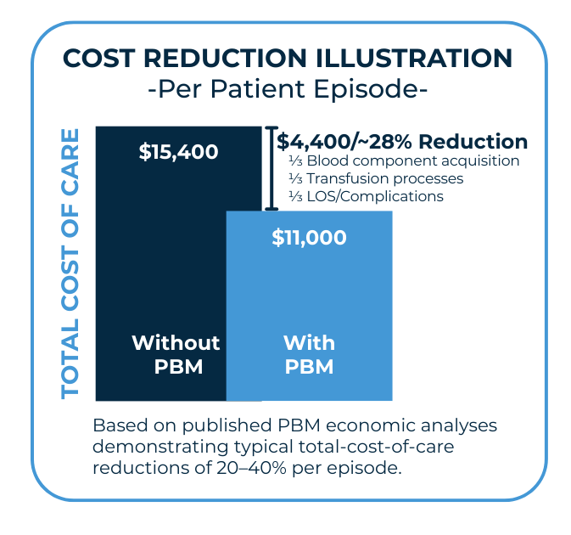
Financial & Operational Impact
Mature PBM programs consistently demonstrate:
Reduced total cost of care Driven by fewer complications, reduced transfusion utilization, and shorter length of stay
More predictable and stable margins Less cost variability across DRGs and service lines
Improved operational efficiency Shorter length of stay frees beds and improves throughput without physical expansion
Better use of existing resources Reduced reliance on high-cost blood components and downstream services
Ability to support evidence-based service growth Including anemia management and optimization pathways aligned with quality goals

Slide 12
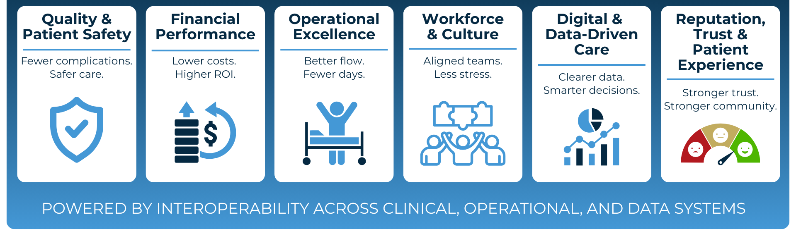
PBM and Enterprise Strategy
PBM advances multiple strategic priorities simultaneously.

Slide 13
Strategic & Governance Core
SECTION 3

Slide 14
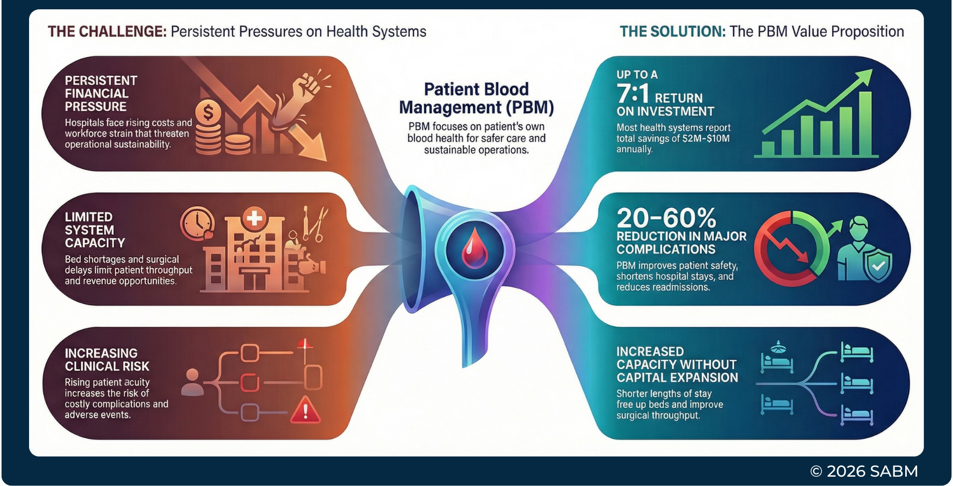
PBM: A Strategic Response to System-Level Pressures
Notes:
This is PBM from a leadership vantage point — a rational response to real system pressures

Slide 15
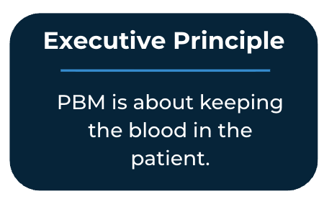
Leadership Is the Difference
Effective Governance
Is embedded in clinical practice and aligned with Quality, not owned by the laboratory
Has clinical authority without blood bank dependency
Maintains C-suite visibility and accountability
Treats transfusion as a clinical outcome, not an owned operation
Is supported by a focused executive dashboard and cross-disciplinary alignment
Is protected as a strategic asset

Slide 16
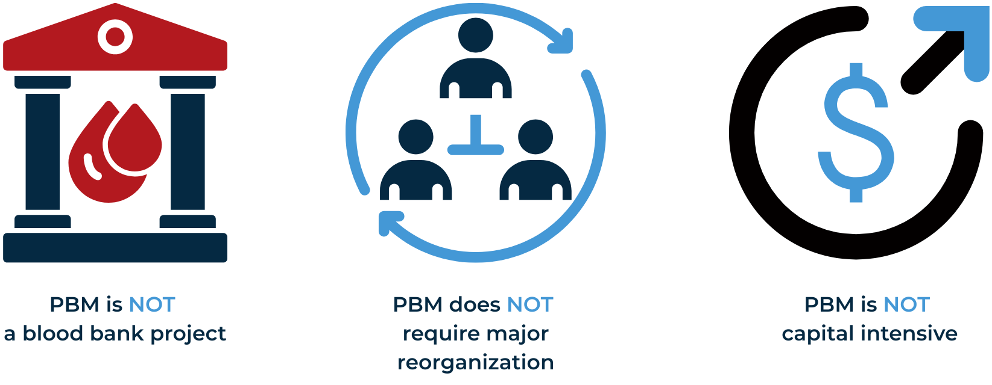
What PBM Is Not

Slide 17
Measuring What Matters: Top 5 Metrics
RBC Transfusion Utilization Rate
Risk-Adjusted LOS
(Transfused vs Non-Transfused)
Major Complication Rate
(AKI, infections, MI, PE, sepsis)
Preop Anemia Screen-and-Treat Rate
PBM Cost Savings / ROI Estimate
A system-level indicator of clinical variation, overuse, and downstream cost.
One of the strongest predictors of financial and operational impact.
A direct marker of safety, quality, and preventable cost.
A leading measure of readiness, efficiency, and surgical safety.
Financial transparency supporting executive and board accountability.
Key Takeaway: Executive oversight requires a small, focused set of meaningful metrics.

Slide 18
Real-World Confirmation
SECTION 4

Slide 19
Real-World Insight
“There’s a significant return on investment (>7.5 fold) for supporting a patient blood management program … you’re going to save blood, save money, and improve outcomes all at the same time.”
Steven M. Frank, MD
The Johns Hopkins Hospital
“Once you get everyone bought into the notion that PBM is not simply about reducing transfusions but also improving patient outcomes, then it fundamentally reshapes the way in which we care for patients.”
Matt A. Warner, MD
Mayo Clinic
“Patient Blood Management is embedded in how we deliver some of our most complex surgical care—including hepatobiliary, pancreatic, cardiac and urology surgery and liver transplantation. It has enabled safer, evidence-based practice with lower transfusion use, while delivering real operational and financial value in an academic medical center.”
Stephanie Hall, MD, Chief Medical Officer
Keck Medical Center of USC

Slide 20
Action & Next Steps
SECTION 5

Slide 21
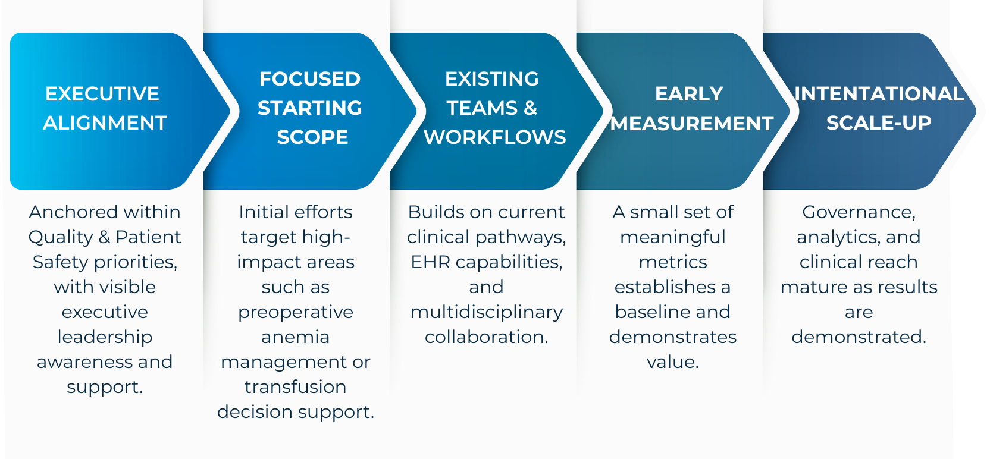
How Organizations Typically Start

Slide 22

What Leaders Can Do Next
Explore PBM further at the SABM Exec Corner: sabm.org/exec-corner
Assign a trusted leader to evaluate PBM for your organization.
The SABM Exec Corner project was made possible through
the generous support of Johnson & Johnson MedTech.

